Slide 1
Event title
Date

Slide 2
Key Facts Of SaxoCell®
Mission
SaxoCell® will bring efficient, safe and affordable autologous and allogeneic Cell- and Gene Therapies (CGTs) to patients who are suffering from serious diseases.
Strategy
We bring excellent fundamental & applied research expertise in Saxony together with industry resources and know-how as well as further national/international partners – thus, we will become the German Cell and Gene Therapy lighthouse with highest international visibility.
Core Partners

Slide 3
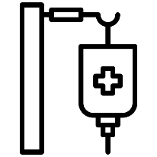
The Vision Of SaxoCell®
Development of novel gene and cell therapeutics i.e. "living drugs“
Cell therapeutics from multiple donors in larger batches at a lower price in automation
Cluster technologies developed with local company partners and represent incentive for investors and industrial partners to get involved in the cluster region
Saxonian science and industry for effective, affordable, safe cell therapy to cure and prevent disease globally
Investments and industry sector growth
R&D projects to improve CGT
Automation for large scale pro-duction
Clinical need for advanced CGTs
Successful clinical appli-cation
Precision
Medicine
CGT: Cell and Gene Therapy R&D: Research and Development

Slide 4
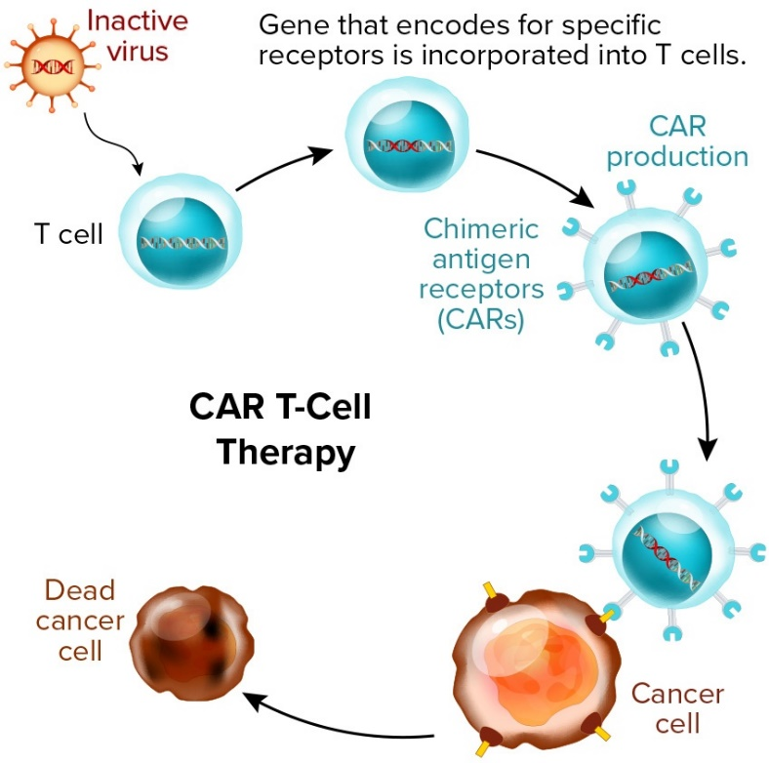
SaxoCell® - The Future Is Now!
Selection of previous successes in the field of cell and gene therapy
Cure for monogenetic diseases, e.g. immunodeficiencies: our CGD study (D-CH)
gene correction in stem cells
Worldwide good results in leukemias & lymphomas with CAR-T cells:
> 50,000 patients; 3 approved compounds
Universal UniCAR T cells (Saxony) - AML
Current challenges
Limited range of application
Long-term product safety
Cost- and time-intensive manufacturing processes
Closing the translational gap - transfer to patient treatment
Germany: < 10% of all worldwide clinical trials
[Gene Therapy Products – BioProcess International]
CGD: Chronic Granulomatous Disease AML: Acute Myeloid Leukemia

Slide 5
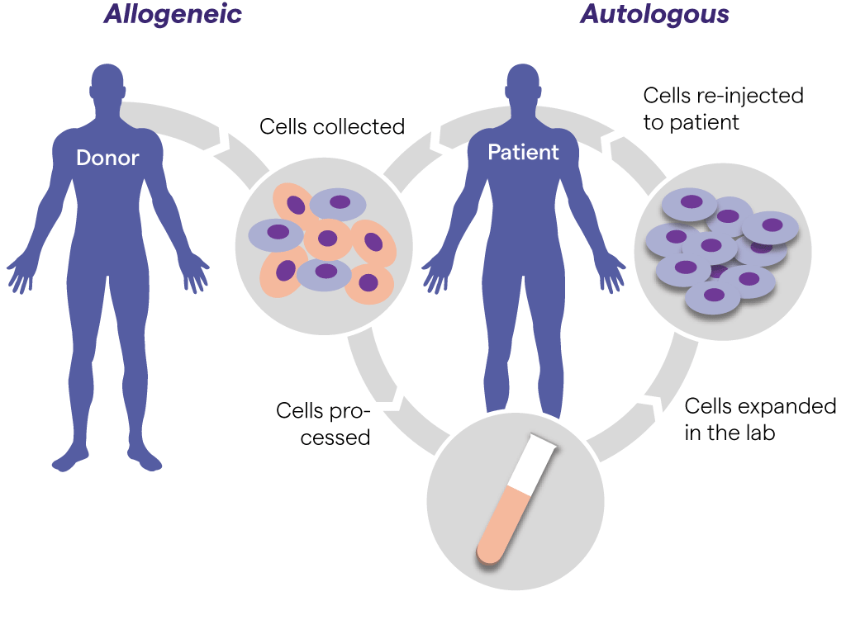
Our Vision For The Future
Affordable, safe treatment of patients suffering from untreatable diseases with cell and gene therapeutics (ATMPs)
Saxony as Europe's hub for ATMPs :
Combination of innovative technologies
Voice for science, economy and politics
Cost reduction (e.g. automated manufacturing / AI)
Growth model: successful transfer to the economy
[Cell and Gene Therapy - Lonza]
ATMP: Advanced Therapy Medicinal Product AI: Artificial Intelligence

Slide 6
Saxony - An Innovation & Transfer Hub
Saxony – the region with a future
Innovation region (successful transformation since 1990)
Excellent education (scientists/doctors/professionals)
Broad established network
Excellent cooperation mentality - extensive synergies
Business-friendly environment: competitive, low costs
Very well developed infrastructure (e.g. DHL Express Global Hub)
Clusters4Future as an accelerator of R&D activities and the transfer culture

Slide 7
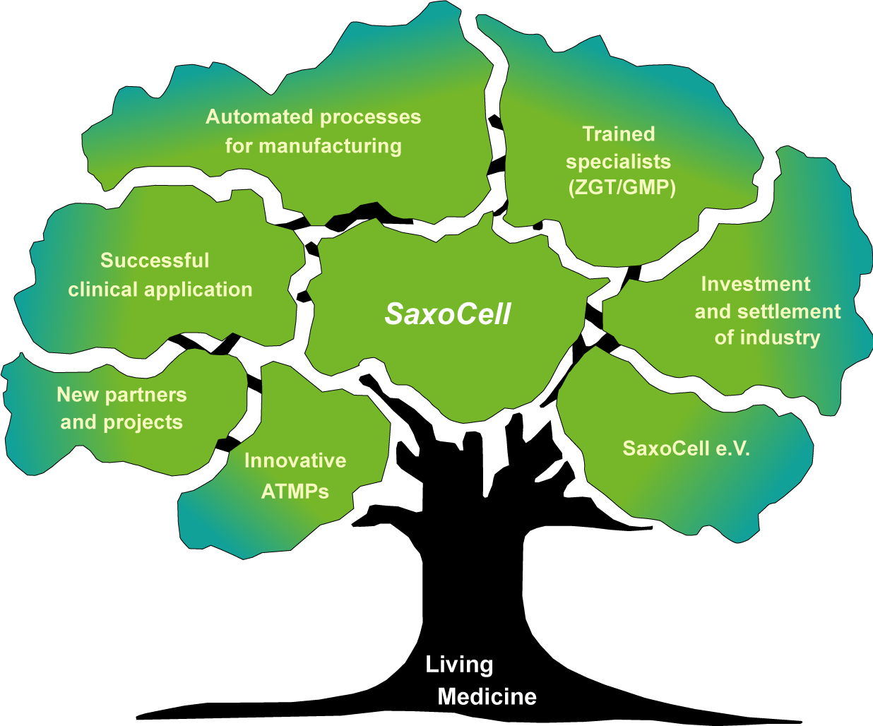
The Moment Is Now...
… to grow Cell and Gene Therapy in Germany for Europe and together worldwide!
Health is not everything, but without health everything is nothing
Arthur Schopenhauer

Slide 8
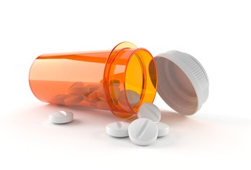
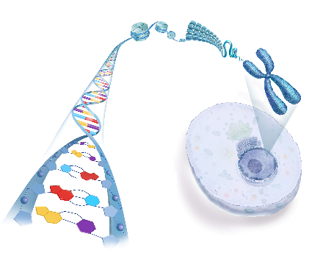
SaxoCell® - Medicine Of The Future
Today - Relief
Precision Medicine
Tomorrow - Cure
Chemical substances
Continuous intake
Relief of symptoms
Immunotherapy
Cell and gene therapy
One time treatment
Correction of the cause
Long lasting effect
Cure of infectious, cancer, monogenetic, autoimmune, cardiovascular and neurological diseases…

Slide 9
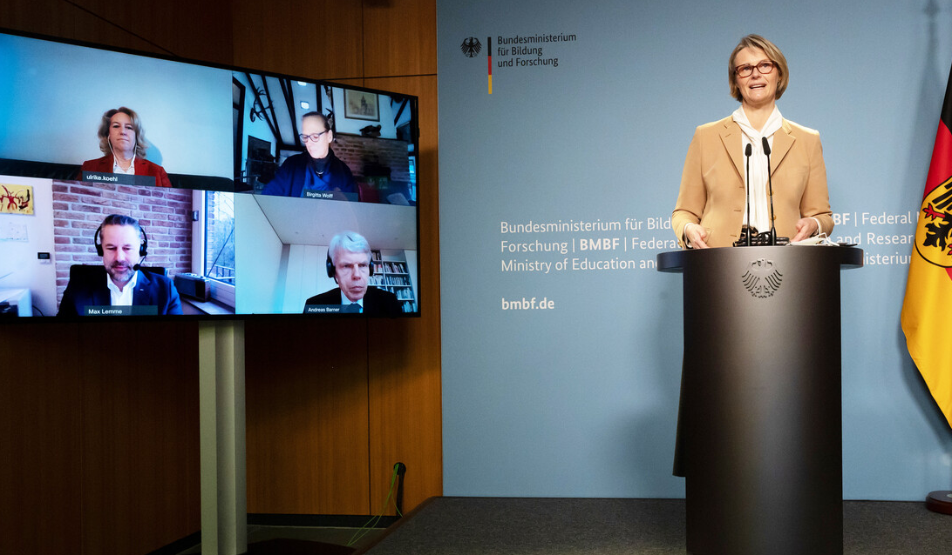
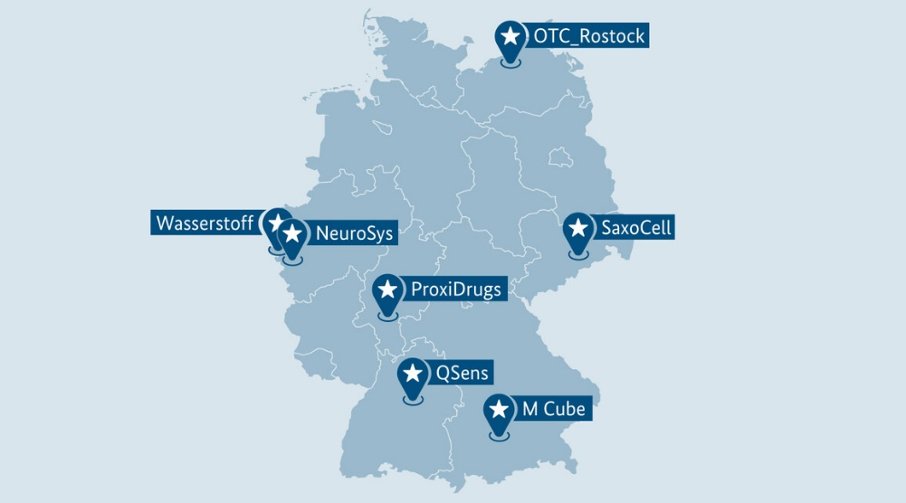
Funding And Funding Sources
Clusters4Future Initiative of the BMBF
137 Germany-wide applicants
SaxoCell is one of seven funded Clusters in the first implementation phase (yellow)
Funding amount: 15 Mio Euro for three years
Federal Research Minister Anja Karliczek announces SaxoCell as a winner in the "Clusters4Future" competition at a press conference. Ulrike Köhl as SaxoCell spokesperson in the upper left. © BMBF/Hans-Joachim Rickel
Winners of the first Clusters4Future funding round.© BMBF

Slide 10
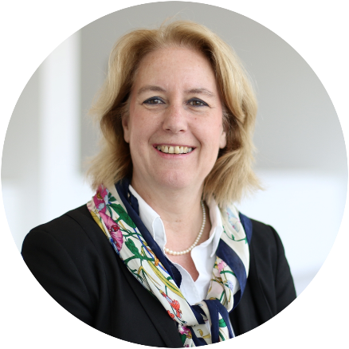
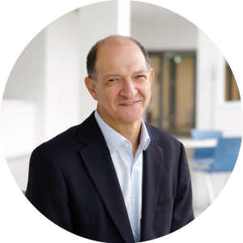
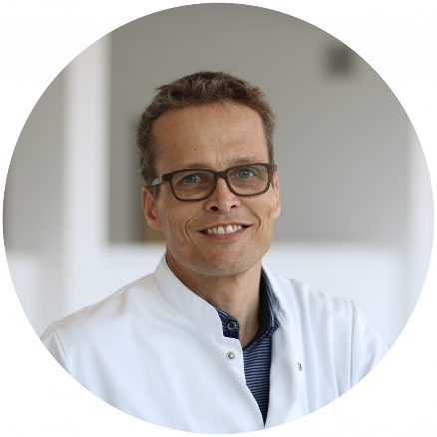
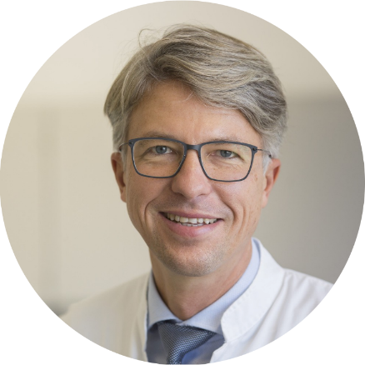
Spokespersons Of The Cluster
Speakers
Co-Speakers
Prof. Dr. Ulrike Köhl
University of Leipzig
Fraunhofer IZI Leipzig
Prof. Dr. Ezio Bonifacio
Technical University Dresden
Prof. Dr. Martin Bornhäuser
Technical University Dresden
Prof. Dr. Uwe Platzbecker
University of Leipzig

Slide 11
Structure Of SaxoCell®
12 R&D projects clustered in 4 areas
Innovation in diagnostics and monitoring
Platform SaxoCell
Omics
Public
Clinical studies, Consulting & management
New academic partners
CAR-T Cells
SaxoCell
Clinics
Diagnostics
Bioinformatics
Data Science
New industry partners
PAP
Project management
ICP
PR, marketing
transfer
NK/CAR-NK Cells
Networking
Clinical studies
BMBF
Clusters
4Future
Cluster marketing & transfer
CMP
Strategy development
Training, PR, Cluster management, project updates
Contact
Further ATMPs
SaxoCell Hub
Patient advocacy
Politics & Regu-lators
CTG ap-proaches
Candidates for automation, AI & robotics
Platform SaxoCell Systems
Training
PAP: Pipeline Accelerator Program; ICP: Innovation Culture Program; CMP: Cluster Matching Program; ATMP: Advanced Therapy Medical products; CTG: Cell and Gene Therapy

Slide 12
SaxoCell® R&D Projects
Preclinical
Early stage
Preclinical
Late stage
„First in human“
studies
Late clinical
studies
TRL1
TRL2
TRL3
TRL4
TRL5
TRL6
AlloCAR-T
CAR-T cells
UltraCAR-T
CAR-NK 4.0
Indications
Cancer
Graft versus Host Disease
Autoimmunity
Wound healing
Hemoglobinopathies
NK/CAR-NK cells
CAReNK-AID
NK4Therapy
HemRec
ZellTWund
Further ATMPs
xMac
MSC PreStiGe
OPTIX
CGT approaches
ECP-CAR
TheraSTAR
TRL: Technology Readiness Level

Slide 13
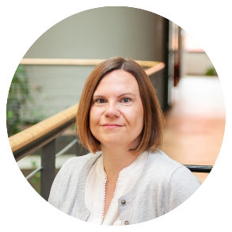
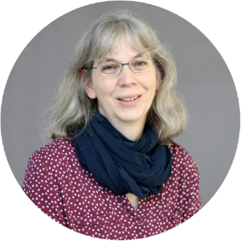
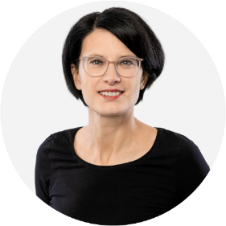
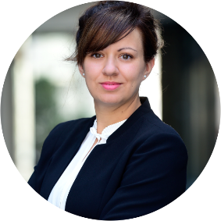
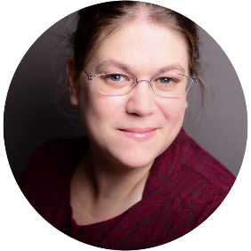
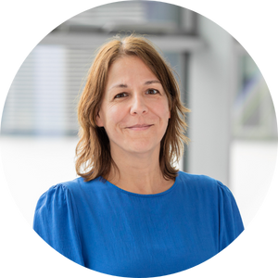
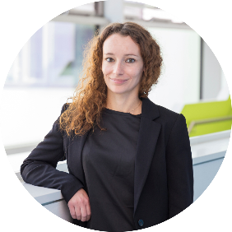
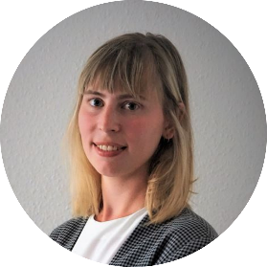
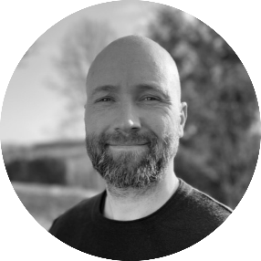
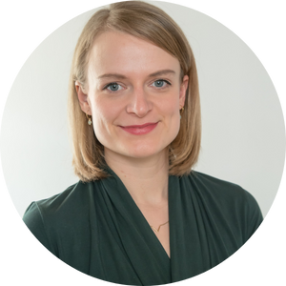
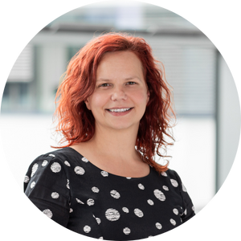
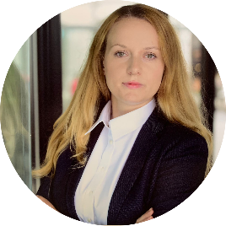
SaxoCell Hub
PAP
Pipeline Accelerator Program
Project management
Identification of new projects
Reporting
Ilka Henze
Maren Henneken
Dorit Teichmann
Stefanie Binder
ICP
Innovation Culture Program
PR, marketing & transfer
Contracts & patents
Trainings & Innovation culture
Anette Bartsch
Ira Illgen
Stephanie Wieneke
Beatrice Berneck
CMP
Cluster Matching Program
Cluster Strategy
Cluster sustainability
Joint Research Infrastructure
Alexander Funkner
Luisa Brückner
Franziska
Friebel-Viehbach
Nicole Modler

Slide 14
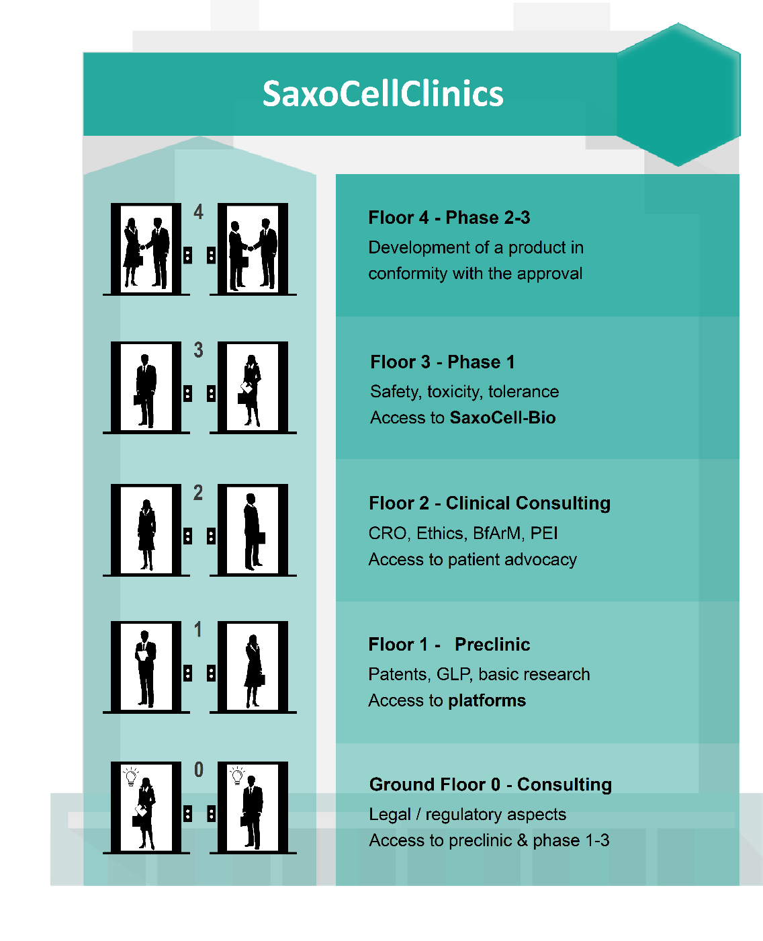
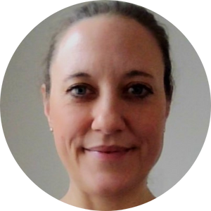
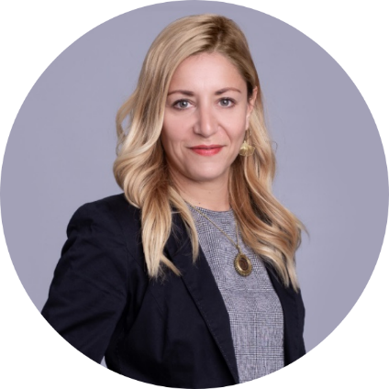
SaxoCell® Clinics
Clinical Trial support
Network and advice for clinical studies
Phase 2-3 for licensed product
Silke Gloaguen
University of Leipzig
Phase 1 trials
Clinical access/advice
Pre-Clinical
Dr. Janine Kirchberg
University of Leipzig
Legal/regulatory

Slide 15
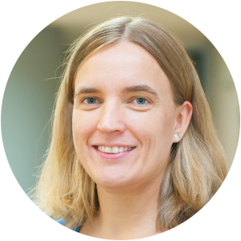
Platform - SaxoCell® Omics
Mechanistic opportunity
Special mechanisms, biomarkers and patient stratification
Platform SaxoCellOmics
TU Dresden, Uni Leipzig, Fraunhofer IZI, ScaDS.AI, ecSeq GmbH
Dr. Kristin Reiche
Fraunhofer IZI Leipzig
SaxoCell
Projects
SaxoCell
Clinics
New projects
Assays
Processing
Interpretation
Validation
Transfer
Genomics
Single cell
Multiparam. flow cytometry
Multispectral Histochemistry
Immunomics
Primary & secondary data
Data storage,
management
& integration
Quality control
Privacy preserving
Machine & Statistical Learning
Knowledge Management
Bioinformatics
Systems Biology
Mechanisms
New targets
Resistance
Biomarkers
Patient stratification
New industry partners
Sample management & processing
Access to SaxoCell Bio
Clinical Metadata
Clinical Studies
Performance evaluation studies
Fit-for-purpose
Better therapies
Prof. Dr. Ezio Bonifacio
Technical University Dresden

Slide 16
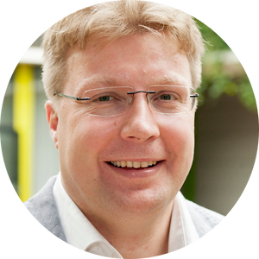
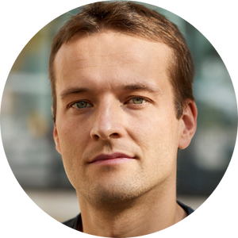
Platform - SaxoCell® Systems
Automation of processes
Optimization and integration of processes for automated manufacturing
Platform SaxoCellSystems
TU Dresden, Uni Leipzig, University Hospital Leipzig, Fraunhofer IZI, ScaDS.AI
PD Dr. Stephan Fricke
Fraunhofer IZI Leipzig
SaxoCell
Projects
ATMPs
Automation
Process
optimization
Quality management
GMP training
Transfer
New projects
CAR-T
NK/CAR-NK
Regenerative medicine
T-cell modulating therapies
AI
Robotics
Deep Learning methods
Smart assistance systems
New industry partners
Quality Control
Supply chain Management
Tissue models
Regulatory support
On-site training
GMP online courses
Qualification
Staff
Fast and safe ATMPs
New manufacturing technologies
Operators
Safety
Efficiency
Availability
Cost Reduction
Better therapies
Dr. Ulrich Blache
Fraunhofer IZI Leipzig

Slide 17
SaxoCell® Academic Partners
Academic Partners (38 PIs)
Technical University Dresden & University Hospital
University Leipzig & University Hospital
Fraunhofer Institute for Cell Therapy and Immunology
Hospital Chemnitz
Helmholtz Center Dresden Rossendorf
TransCampus Dresden
Center for clinical Studies (Leipzig and Dresden)
And many more…

Slide 18
SaxoCell® industry partners
NATIONAL
Industrial partners in the first funding phase of the SaxoCell Cluster:
Regional companies from Saxony
DKMS Life Science Lab
MDTB Cells
Cell.Copedia
ecSeq bioinformatics
T-Cell Tolerance
National companies
Miltenyi Biotec
T-Crux
Affimed
REGIONAL
Miltenyi Biotec
ecSeq bioinformatics
T-Cell Tolerance
DKMS Life Science
T-CURX
Cell.Copedia
MDTB Cells
Leipzig
Dresden
Affimed
Chemnitz

Slide 19
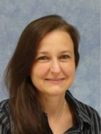
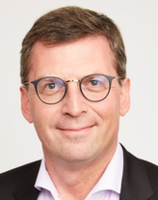
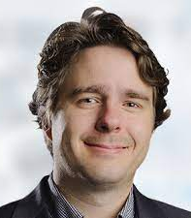
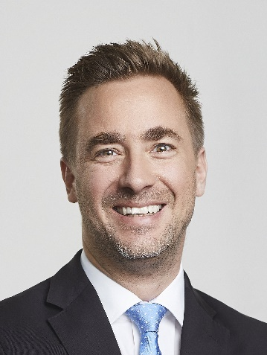
Scientific Advisory Board
The external advisory board is composed of recognized experts who are able to provide profound insight and advice regarding SaxoCell's manifold activities.
Prof. Ute Modlich
Paul Ehrlich Institut, Langen
Dr. Lorenz Mayr
Syncona / ETH Zürich
Prof. Axel Schambach
MHH, Hannover
Dr. Jessica Morison
CRISPR Therapeutics, Boston
Jan Geissler
Patient advocacy, München
Nadine Winter
Patient advocacy, Dresden

Slide 20
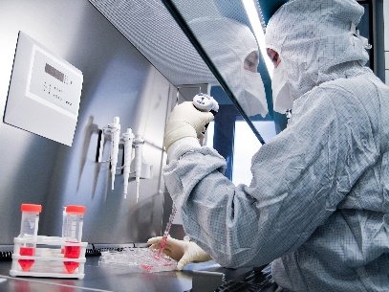
SaxoCell Assets Excellent Partners and Infrastructure plus Innovative Technologies
Cutting-edge innovation: Technologies developed and patented in Saxony
Innovative genome-editing technologies (Designer Recombinases)
Organ-specific viral vectors and next-generation CAR-NK therapies
Antibody and protein design for improved CARs
Exceptional security system for CAR-T cells (UniCAR)
Excellent academic & industry partners
One of Europe´s largest and most experienced GMP manufacturing facilities
Different ATMPs including CAR-T and CAR-NK cells, iPS & macrophages
GMP training for industry and academia
Partner centers at the forefront of digital medicine / AI & clinical networks
CAR-T cells from Saxony: 5 years from laboratory to patient
Approved studies, health research center, EU-wide ATMP networks
Leipzig
Dresden
Chemnitz

Slide 21
Our competences
Innovation: Technologies developed and patented in Saxony
UniCAR system and genome editing (designer recombinases)
New gene transfer systems
Computer-aided receptor and antigen design
Europe's largest academic GMP manufacturing facility
Various ATMP (CAR-T-/ CAR-NK cells, iPS, macrophages ...)
Large patent portfolio
GMP training center (for industry and academia)
Clinical networks - therapies with living drugs
CAR-T cells from Saxony: 5 years from lab to patient
Regulatory studies, health research center, EU-wide ATMP networks
Leipzig
Dresden
Chemnitz
GMP: Good Manufacturing Practice NK: Natural Killer cells iPS: induced pluripotent stem cells

Slide 22
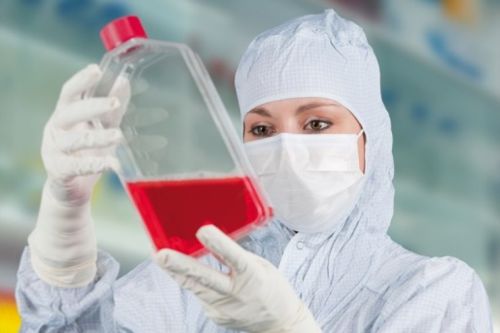
Business Unit Cell & Gene Therapy at Fraunhofer IZI
Cell and Gene Therapy R&D Value Chain
Proprietary cell therapy product candidates (examples):
Clinical: Cell bioreactor-based therapy of sepsis
Late preclinical: Palintra® - Combined ATMP for GvHD treatment
Preclinical: Improved cancer treatments employing CAR-modified T/NK cells
Discovery: Viral vectors for ex-vivo modification of therapeutic cells and in vivo gene therapy
1. Early Development
2. GLP Safety & Efficacy
3. GMP Process Development
4. GMP Manufacturing
5. Clinical Trials
Licensing and Joint R&D
Fee for service
Licensing and joint R&D
Complementary technologies (examples):
mRNA-based iPSC generation
Automation of manufacturing and QC
Inactivation of cell therapy products by electron beam irradiation
Manufacturing processes for „off-the-shelf“ NK cell therapeutics

Slide 23
Activity areas of SaxoCell®
Development of efficient, safe and affordable autologous/allogeneic CGTs → efficient and quick translation from the bench to bed
Development of novel platform technologies for CGT R&D (gene editing, improved viral vectors and non-viral gene delivery systems)
Development of a pipeline of innovative cell and gene therapies
GMP-compliant automation of cell therapy manufacturing and QC
AI methods to improve patient stratification and personalized treatments
Generation of an optimal and innovation-oriented environment in the cluster
Intensified education of CGT-qualified staff (e.g. GMP) to address upcoming bottlenecks for the industry
Further increased attractiveness of Saxony for international partners and investments
Leipzig
Dresden
Chemnitz
CGT: Cell and Gene Therapy R&D: Research and Development GMP: Good Manufacturing Practice QC: Quality Control

Slide 24
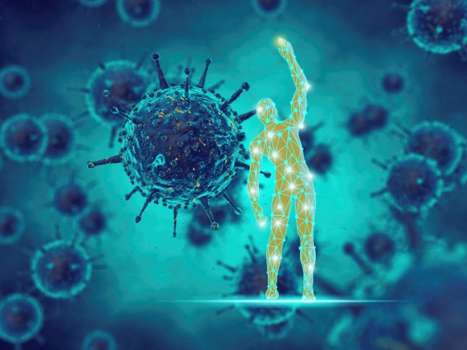
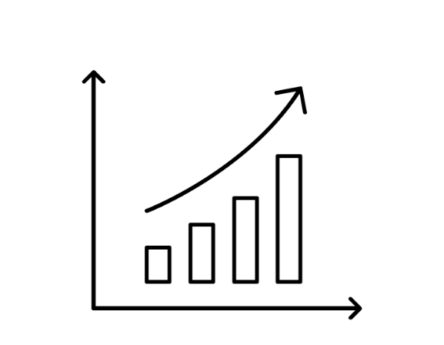
Roadmap 1 Technical & Clinical Innovations
5 years from now
10 years from now
20 years from now
Accelerated translation of ATMPs i.e. designer-recombinase platforms to approval, in particular for cancer treatment
New optimized processes for production of ATMPs and vectors
GMP training center for Europe
Breakthrough treatments for several diseases available
New and adaptable technologies for personalized medicine (in vivo & ex vivo therapies)
Process lines, Robotics, AI, Industry 4.0 – Cost reduction
Cost-effective healing of many diseases possible
Universally applicable genome surgery and „off the shelf“ therapies
Partially automated production
Designer- recombinases
ATMP studies phase III/IV
Full automation
Increased quality of life

Slide 25
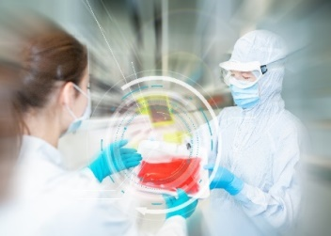
Roadmap 2 Economic & Social Innovations
5 years from now
10 years from now
20 years from now
SaxoCell® brand well established
Strong voice of the cell and gene therapy sector in Germany towards politics, regulatory authorities and stakeholders
Several new jobs created
High worldwide visibility achieved
Track record of successfully established cell and gene therapy companies in Saxony
Well established Saxon training and education for ATMPs
Saxony is the leading cell and gene therapy location in Europe, Germany
Large international investments realized in the cell and gene therapy sector in Saxony
ATMP Network
Leipzig
Leipzig
Dresden
Dresden
Chemnitz
Chemnitz
DHL/ World Courier Hub Halle/Leipzig

Slide 26
Benefits for the Industry
Substantial gain regarding impact and visibility in the rapidly developing market of gene and cell-based therapies
Participation in joint development projects with renowned research partners
Active development and partnership with start-up companies
Access to infrastructure, expertise and funding
Becoming a part of the cluster’s stakeholder network, comprising national and international scientific and clinical institutions, governmental and regulatory bodies as well as investors
Participation in professional training and educational activities
Access to innovative product candidates and technologies

Slide 27
SaxoCell® Cluster started on 1st of October 2021
Investments and industry sector growth
R&D projects to improve cell & gene therapy
Automation for large scale pro-duction
Clinical need for advanced therapies
Successful clinical application
Precision
Medicine

Slide 28
For questions and further information please contact:
info@saxocell.de

